Slide 1
Leading Your Way Out of Technical Debt
Arlo Belshee

Slide 2
We asked 104 teams at Tableau – all in one company, working on only 3 different products and with a ton of code sharing
[visual of results]
Notes:
2m

Slide 3
The Impossible Situation
Results: There is not a consistent problem.
YET…
Leadership’s job is to set a consistent direction.
Others’ jobs are to figure out how to go that direction.
That won’t work for technical debt.
Now what?
Notes:
.5m

Slide 4
A New Kind of Leadership
We need companies to effectively go in many different directions in an aligned way.
Notes:
.25m

Slide 5
Requires Everyone to Shift
New behaviors in every role, not just leaders.
Can be instigated by anyone.
Notes:
.25m

Slide 6
Commitment
Direction
Team
Leader
Execute
Feedback
Assess
Accountability Loop
What we do today

Slide 7
Impact on Technical Debt
Doesn’t work
Example
Notes:
1m

Slide 8
Ownership Loop
Assess
Commitment
Direction
Direction
Team
Leader
Execute
Feedback
Assess
Accountability Loop

Slide 9
Ownership Loop
Assess
Leader
Mentor
Coach
Direction
Team
Execute

Slide 10
Impact on Technical Debt
Ownership solves it!
Example from Tableau
Notes:
2m

Slide 11
Except that Breaks Leaders
Leaders are told their job is to:
make decisions,
improve people, and
ensure the right work gets done
Ummmm. That’s impossible with real ownership.
Notes:
.5m

Slide 12
How to not break leaders … and not have technical debt
Instead of asking leaders to
make decisions,
improve people, and
ensure the right work gets done
Let’s ask them to
improve others’ ability to make decisions
be people’s mirrors, and
help people understand what they do and don’t know
Notes:
1m

Slide 13
If we succeed implementing those?
Balance team autonomy with responsibility. Autonomy doesn’t go wild; leaders don’t stifle action.
And this allows local alignment and action, without requiring global alignment. Exactly what we need in order to solve Technical Debt.
Notes:
.5m

Slide 14
Great Theory…Now How Do We Do It?
Notes:
.25m

Slide 15
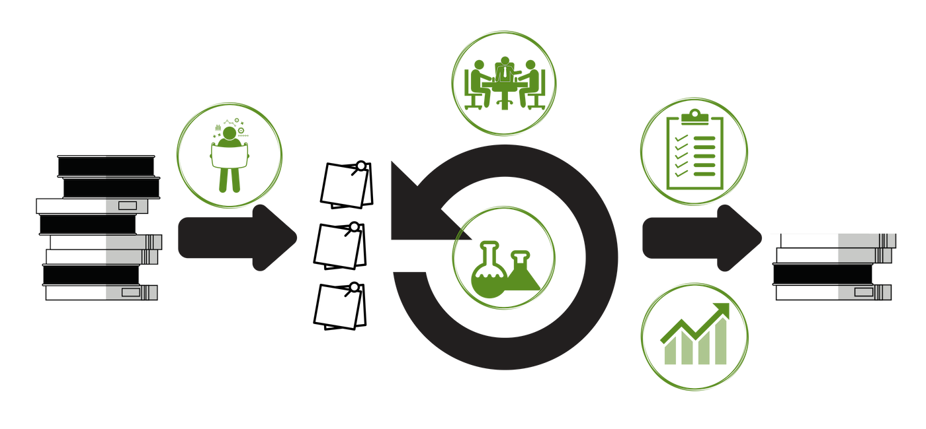
Let’s Break Down DDL
Notes:
.25m

Slide 16





What will this change?
Adjusts your planning game where you plan different work
Adjusts your sprint where you do and track work differently
Adds an ownership event where leaders help teams build ownership
Adjusts how ownership is assessed
Adjusts your demo where talk about success differently
Notes:
1m

Slide 17
Part 1: Planning Experiments
Individual teams identify and agree upon metrics and experiments that they locally need.
NEW CONCEPT: experimentation versus improvement
Notes:
.5m

Slide 18
Part 2: Running Experiments
Tracking measurements and experiments throughout sprint.
NEW CONCEPT: none
Notes:
.25m

Slide 19
Part 3: Leading Ownership
Creating a regular structure for leaders supporting teams achieving greater and greater ownership over time.
NEW CONCEPT: stances to how leadership and teams show up
Notes:
.5m

Slide 20
Part 4: Assessing Ownership
Finding the really clear picture of where every team is and what is possible
NEW CONCEPT: a reflection of moving from accountability to ownership
Notes:
.25m

Slide 21
Part 5: Showing Improvement
Demo turns into product and improvement demo
Audience: team + customers
NEW CONCEPT: experiment versus improvement
Notes:
.5m

Slide 22
OK, so for the real change….
There were two new concepts:
Experiment versus improvement
Stances to how leadership and teams show up
Notes:
.25m

Slide 23


New Concept #1: Experimenting vs Improving
Notes:
2m
Experiment vs improvement
The purpose of an improvement is to directly reduce debt – you know your ROI
The purpose of an experiment is to learn what improvements should be done later – you’re finding the ROI
Understanding the proper ratio between experiments and improvements

Slide 24

New Concept #2: Shifting Stance
Notes:
2m
Shifting from task to mindset – ACTUALLY trusting the teams to run your business. How many dollars do you lose by letting teams screw up versus how many dollars do you lose by NOT letting teams innovate?
And yes, there is a way to do this without leaders losing their jobs!
Tableau story

Slide 25



Leadership Stance
Notes:
1m

Slide 26


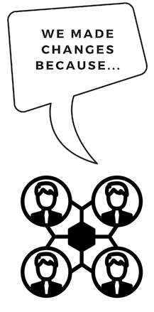

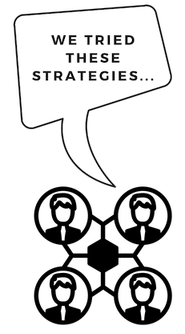
Team Stance
Notes:
1m

Slide 27
Leading Ownership – Skills Required
It just takes practice and intentional awareness
Pair split experiment (leader vs doer)
Yeah. It’s hard. I do offer workshops. /innocent/
Notes:
10m

Slide 28
Leading Ownership - How
Set up recurring meetings where the teams present: 1) good measurements 2) decision making
where management reflects 1) what aspects teams own well and owns poorly
Notes:
.5m

Slide 29
Leading Ownership - Steps
Meet weekly, for 7 min
Attendees: exec + team
Optional: other teams that report to the exec
Agenda:
Team: Show current data
Team: What was learned since last time?
Team: How did that insight change what we measure?
Team: Any overall changes in technical strategy
Team: Any resources we need, and on what timeline?
Exec: ask what informed any specific decision
Exec: observe and express examples of successful or non-successful ownership throughout presentation
Notes:
1m

Slide 30
Key Point
This kind of leadership requires different behavior out of everybody
But that means that it can be started by anybody
Notes:
.5m

Slide 31
Change how you participate…
Whether you’re a PO, M1, IC, or exec
Notes:
.25m

Slide 32
How to Start – Product Owner
demand at demo that tech debt plan is shared.
Don't assume tech debt is unsolvable.
Accept it as a reason that X can’t happen, and then ask for a plan how they will change it so that X can happen later.
Notes:
1m

Slide 33
How to Start – Team Manager / Lead
Designate a team IC to be a data champion (tech debt owner) and support that person.
Play the role of exec initially.
Request that your exec take over the exec role.
Notes:
1m

Slide 34
How to Start – Any Individual Contributor
Get agreement from team and simply BE the tech debt data owner
Start presenting differently at demos
Define the tech debt improvements / experiments, work with the PO to get them to quality (small, understandable), and bring them to the planning game for real
Start doing Disciplined Refactoring
Notes:
1m

Slide 35
How to Start – Exec
Understand Accountability cycle & Ownership cycle. Present it (frequently) to the team.
Start the tech debt ownership-spectives and assume the proper leadership stances
Start looking for places where you are supporting accountability, and ask what you could do instead to support ownership.
Yes, you can literally ask the team
Notes:
1m

Slide 36
The Choice is Yours; the Reward is Simple
You get to start fixing technical debt and feel supported in doing so …. Tomorrow.
Notes:
1m

Slide 37
Leadership Responsibilities
Gather Disparate Info
Gain Alignment on a Direction
Ensure Work Gets Done
Help Teams See What They Do Well (And Poorly)
Supply Opportunities to Improve

Slide 38
LDD
Breaks habit of looking to leader for direction
Team + leader can see how each team is doing
Leaders have clear opportunities to help improve team decision-making, without needing to be in the loop on decisions
Rewards teams for taking action, for making healthy mistakes, and for learning.

Slide 39
Results
Balance team autonomy with responsibility. Autonomy doesn’t go wild; leaders don’t stifle action.
And this allows local alignment and action, without requiring global alignment. Exactly what we need in order to solve Technical Debt.
Notes:
Update from Slide 6’s breakdown of leadership

